Slide 1
Magenic Masters React Props and State
Jan 31, 2017
Mily Opena

Slide 2
What You’ll Learn Today
Props
State
Events
List
Composition over Inheritance

Slide 3
Props

Slide 4
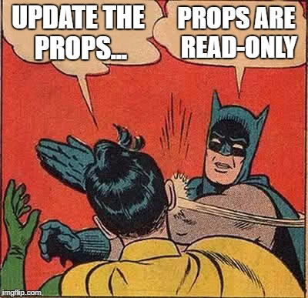
Props
Just a reminder…

Slide 5
Props
A key factor to make components reusable and composable is the ability to configure them
Props are a component’s configuration

Slide 6

Props

Slide 7
Props
Props are the mechanism used in React for passing data from parent to child components
Props are passed and “owned” by the parent

Slide 8
Props
Props are immutable
They can’t be changed from inside the child components

Slide 9
Props
React is pretty flexible but it has a single strict rule
All React components must act like pure functions with respect to their props

Slide 10
Props
Props in JSX
There are several different ways to specify props in JSX

Slide 11

Props in JSX
JavaScript Expressions
You can pass any JavaScript expression as a prop, by surrounding it with {}

Slide 12

Props in JSX
String Literals
You can pass a string literal as a prop

Slide 13


Props in JSX
Props Default to "True"
If you pass no value for a prop, it defaults to true

Slide 14
Props
Demo
“Wish List”

Slide 15
Best Practice: propTypes
Think of propTypes as a love letter to whatever developer will work on a component after you
Your components should be as declarative as possible

Slide 16
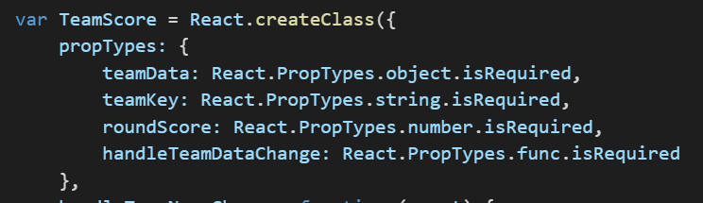
Best Practice: propTypes
propTypes example

Slide 17
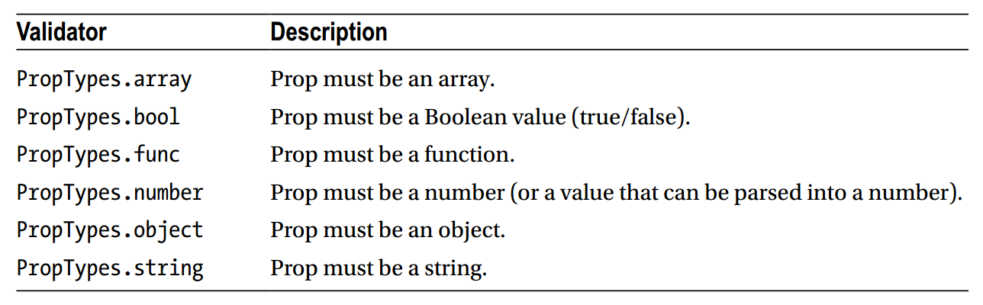
Best Practice

Slide 18
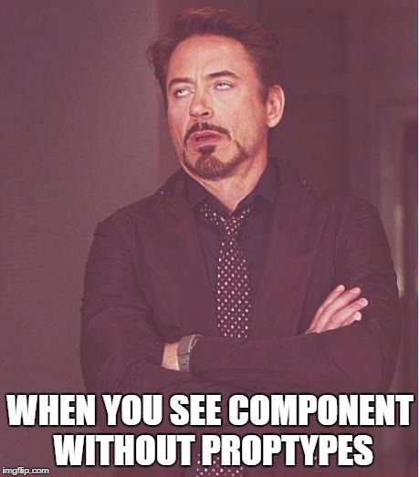
Best Practice: propTypes

Slide 19
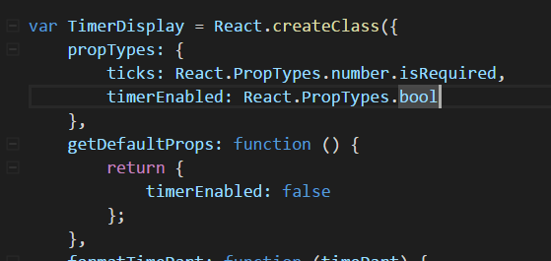
Best Practice
Use getDefaultProps
For any propType that isn't requireds

Slide 20
States

Slide 21
States
Allows you to create components that are dynamic and interactive
It determines how that component renders and behaves

Slide 22
States
State is similar to props, but it is private and fully controlled by the component
Props are external and controlled by whatever renders the component

Slide 23
States
States are mutable
It defines at any given time, the current state of the React component that is being rendered

Slide 24
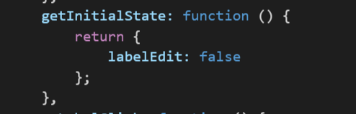
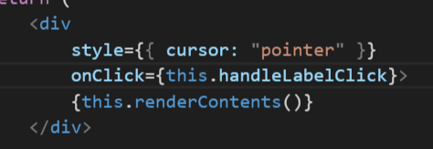
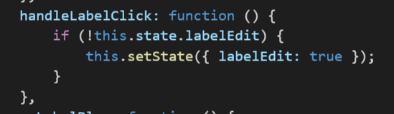


States
In general, you should initialize state in the constructor, and then call setState when you want to change it.

Slide 25
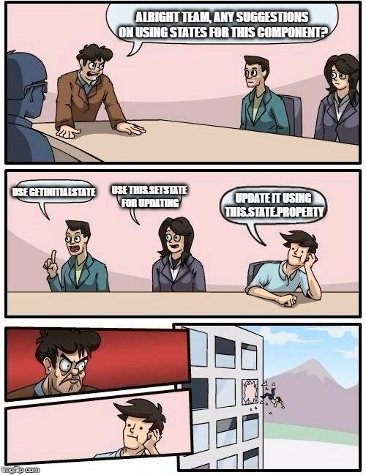
Best Practice: Use this.setState

Slide 26
Props
Demo
“Add Wish”

Slide 27
Events Handling

Slide 28
Events Handling
Handling events with React elements is very similar to handling events on DOM elements
There are some syntactic differences:

Slide 29
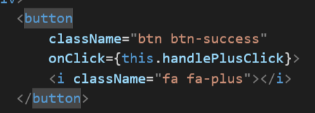
Events Handling
React events are named using camelCase, rather than lowercase

Slide 30
Events Handling
With JSX you pass a function as the event handler, rather than a string

Slide 31
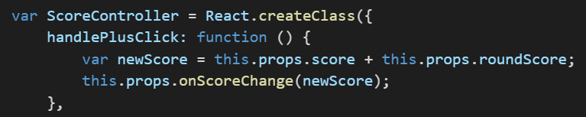
Events Binding
If you use React.createClass, React autobinds all functions to this

Slide 32
Events Binding
In ES6, you have to manually bind your event handlers to this
We will discuss more about ES6 in the next sessions

Slide 33
List and Keys

Slide 34
List and Keys
Keys help React identify which items have changed, are added, or are removed
Most often you would use IDs from your data as keys

Slide 35
Props
Demo
“add key”

Slide 36
Composition vs Inheritance

Slide 37
Composition vs Inheritance
Use composition instead of inheritance to reuse code between components
“At Facebook, we use React in thousands of components, and we haven't found any use cases where we would recommend creating component inheritance hierarchies”

Slide 38
Containment
Some components don't know their children ahead of time
This is especially common for components like Sidebar or Dialog that represent generic "boxes"

Slide 39
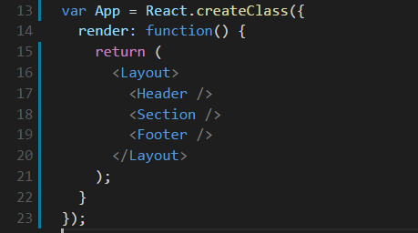
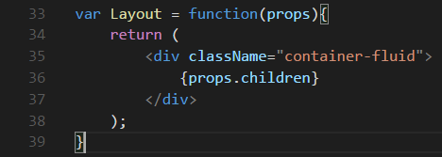
Containment

Slide 40
Specialization
Sometimes we think about components as being "special cases" of other components

Slide 41
Specialization
In React, this is also achieved by composition, where a more "specific" component renders a more "generic" one and configures it with props

Slide 42
Props
Demo
“Wish list item”

Slide 43
Agenda Next Session
Quiz
Assignment
Assignment #2, EOD Thursday

